Slide 1
The Gift of Time

Slide 2
INSERT IMAGE
Pilot free-falling

Slide 3
Ways to Spend Quality Time
Family Worship

Slide 4
Ways to Spend Quality Time
Family Worship
Listening and Affirming Conversations

Slide 5
Ways to Spend Quality Time
Family Worship
Listening and Affirming Conversations
Doing Activities Together

Slide 6
He is Near to Us
“The Lord is near to those who have a broken heart, and saves such as have a contrite spirit” (Psalm 34:18).
“The Lord is near to all who call upon Him, to all who call upon Him in truth” (Psalm 145:18, NKJV).

Slide 7
He is Near to Us
“Behold, I stand at the door and know. If anyone hears My voice and opens the door, I will come in to him and dine with him, and he with Me” (Rev. 3:20).

Slide 8
He Reminds Us
“You have plowed wickedness; you have reaped iniquity. You have eaten the fruit of lies, because you trusted in your own way,” (Hosea 10:13).

Slide 9
He Reminds Us
“Sow for yourselves righteousness; reap in mercy; break up your fallow ground, for it is time to seek the Lord, till He comes and rains righteousness on you,” (Hosea 10:12).

Slide 10
INSERT IMAGE
Pilot free-falling

Slide 11
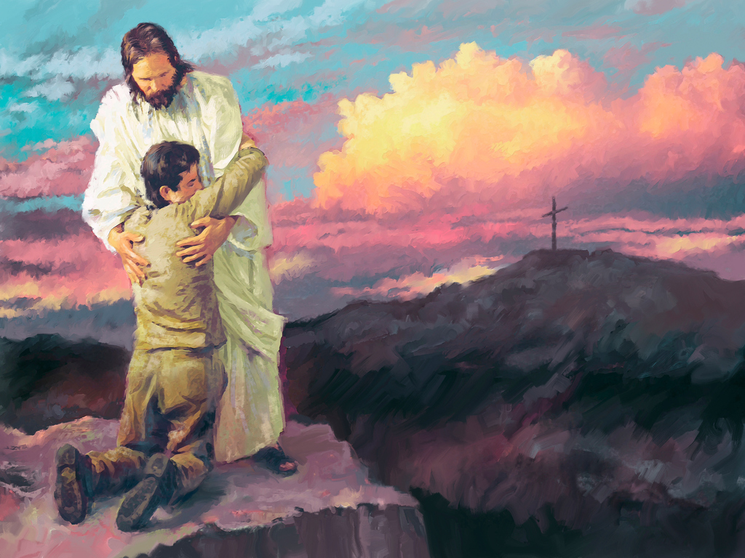
Cling to Christ
Clinging to Christ is our only hope in a fearful, free-falling world.

