Slide 1
Of Assets and Attitudes

Slide 2
Question 1
According to Maslow’s theory of motivational behavior, what is the first need that we strive to fulfill?

Slide 3
Question 2
After the psychological needs, what comes next in our hierarchy of needs?

Slide 4
Question 3
What is at the pinnacle of Maslow’s pyramid?

Slide 5
LEVEL ONE:
Self-Interest

Slide 6
Matthew 8:5-10 NIV
When Jesus had entered Capernaum, a centurion came to him, asking for help. (6) “Lord,” he said, “my servant lies at home paralyzed and in terrible suffering” (7) Jesus said to him, “I will go and heal him.” (8) The centurion replied, “Lord, I do not deserve to have you come under my roof. But just say the word, and my servant will be healed. (9) For I myself am a man under authority, with soldiers under me. I tell this one, ‘Go,’ and he goes; and that one, ‘Come,’ and he comes. I say to my servant, ‘Do this,’ and he does it.”

Slide 7
LEVEL Two:
Obedience

Slide 8
Matthew 8:5-10 NIV
When Jesus had entered Capernaum, a centurion came to him, asking for help. “Lord,” he said, “my servant lies at home paralyzed and in terrible suffering.”

Slide 9
Matthew 8:5-10 NIV
Jesus said to him, “I will go and heal him.” The centurion replied, “Lord, I do not deserve to have you come under my roof. But just say the word, and my servant will be

Slide 10
Matthew 8:5-10 NIV
healed. For I myself am a man under authority, with soldiers under me. I tell this one, ‘Go,’ and he goes; and that one, ‘Come,’ and he comes. I say to my servant, ‘Do this,’ and he does it.”

Slide 11

“These brain studies show the profound state of joy and delight that comes from giving to others. It doesn’t come from dry action– where the act is out of duty in the narrowest sense, like writing a check for a good cause. It comes from working to cultivate a generous quality– from intera https://www.istockphoto.com/vector/silhouette-of-a-mans-head-gm898672018-247983868 cting with people. There is the smile, the tone in the voice, the touch on the shoulder. We’re talking about altruistic love.”
-Jeanie Lerche Dacis “The Science of Good Deeds”

Slide 12
LEVEL Three:
BIBLICAL UNDERSTANDING

Slide 13
Psalm 24:1
“The earth is the Lord’s and everything in it, the world and all who live in it.”

Slide 14
Ecclesiastes 5:15
“Naked a man comes from his mother’s womb, and as he comes, so he departs. He takes nothing from his labor that he can carry in his hand.”

Slide 15
Matthew 6:19 - 21
“Do not store up for yourselves treasures on earth, where moth and rust destroy, and where thieves break in and steal. But store up for yourselves treasures in

Slide 16
Matthew 6:19 - 21
heaven, where moth and rust do not destroy, and where thieves do not break in and steal. For where you treasure is, there your heart will be also.”

Slide 17
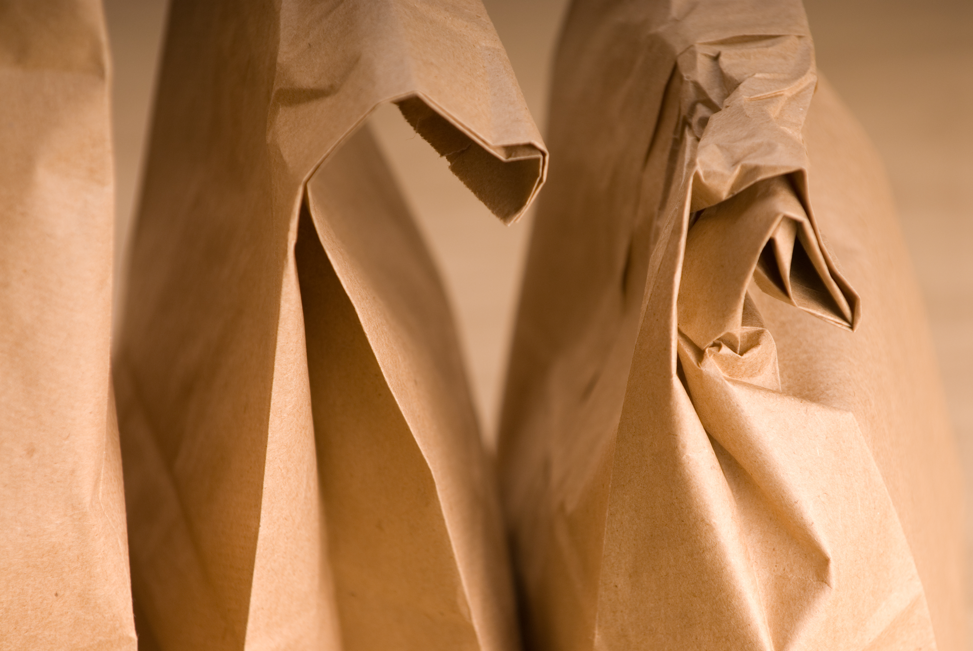
https://www.istockphoto.com/photo/bag-lunch-gm172201593-3302290

Slide 18
LEVEL Four:
Gratitude

Slide 19
Psalm 116:12
“What can I give back to God for all that He has given to me?”

Slide 20
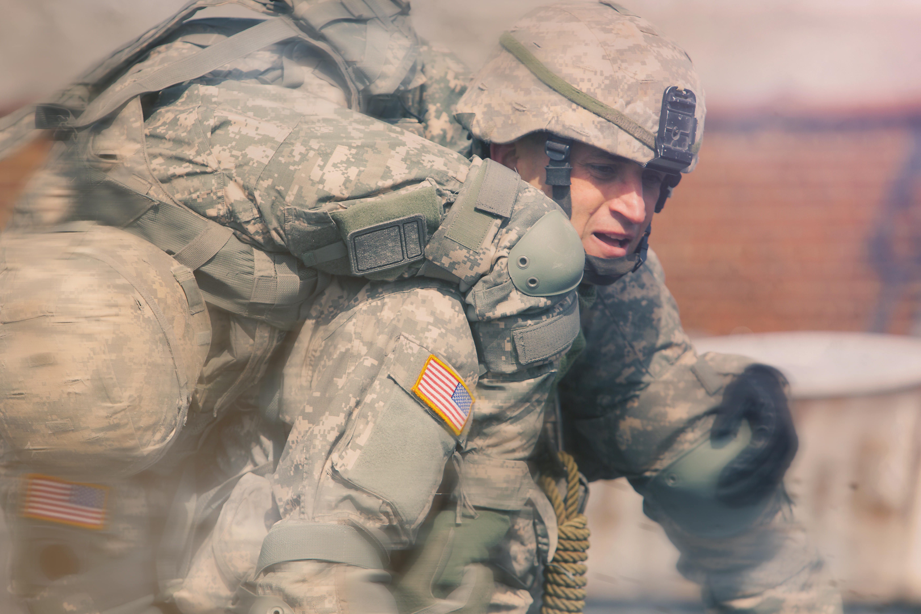

Slide 21
Ellen White (5T 285)
“When the light and love of Jesus illuminate the hearts of His followers, there will be no occasion for urging or begging their money or their service.”

Slide 22
LEVEL Five:
Sacrificial Love

Slide 23
2 Corinthians 9:6-7
“Remember this: Whoever sows sparingly will also reap sparingly, and whoever sows generously will also reap generously. Each man should give what he has decided in

Slide 24
2 Corinthians 9:6-7
“his heart to give, not reluctantly or under compulsion, for God loves a cheerful giver.”

Slide 25
